Slide 1
Exercise 2.3 : We want to design a reactive component with three Boolean input variables x, y, and reset and a Boolean output variable z. The desired behavior is the following. The component waits until it has encountered a round in which the input variable x is high and a round (could be the same) in which the input variable y is high, and as soon as both of these have been encountered, it sets the output z to high. It repeats the behavior when, in a subsequent round, the input variable reset is high. By default the output z is low. For instance, if x is high in rounds 2,3,7,12, y is high in rounds 5,6,10, and reset is high in round 9, then z should be high in rounds 5 and 12. Design a synchronous reactive component that captures this behavior. You may want to use the extended-state machine notation

Slide 3
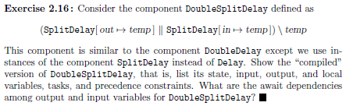

Slide 4


